Slide 1
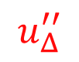
$$u_{Δ}^{′′}$$
High frequency content
of the LES PG:
Velocity response to PG:
Laminar viscous sublayer

